Slide 1

Our Process
DATA MINING
DATA CLEANING
VISUALIZATION
MACHINE LEARNING
WEB DEVELOPMENT

Slide 2
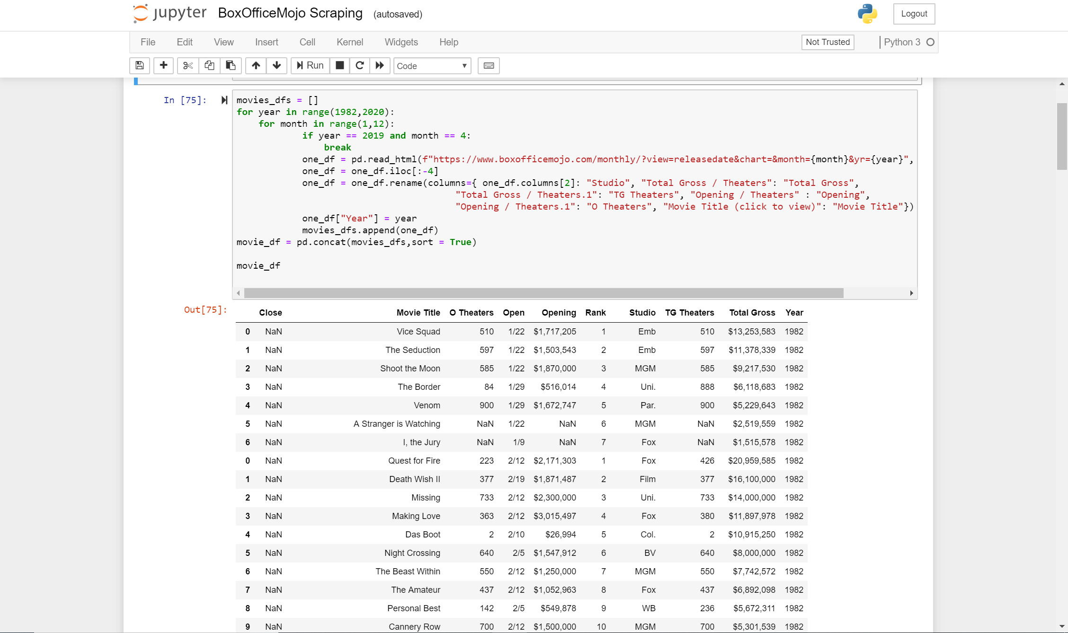
Scrapping Box Office Mojo
Notes:
-Movie Mojo made the data very accessible and big enough data to be more accessible.
-When scrapping box office we had to decide our range of movies that we wanted to included

Slide 3

Data Cleaning
Trying to find the misc. characters in the data.
Dealing with incomplete/empty records.
Data type conversion
Handling failed requests

Slide 4
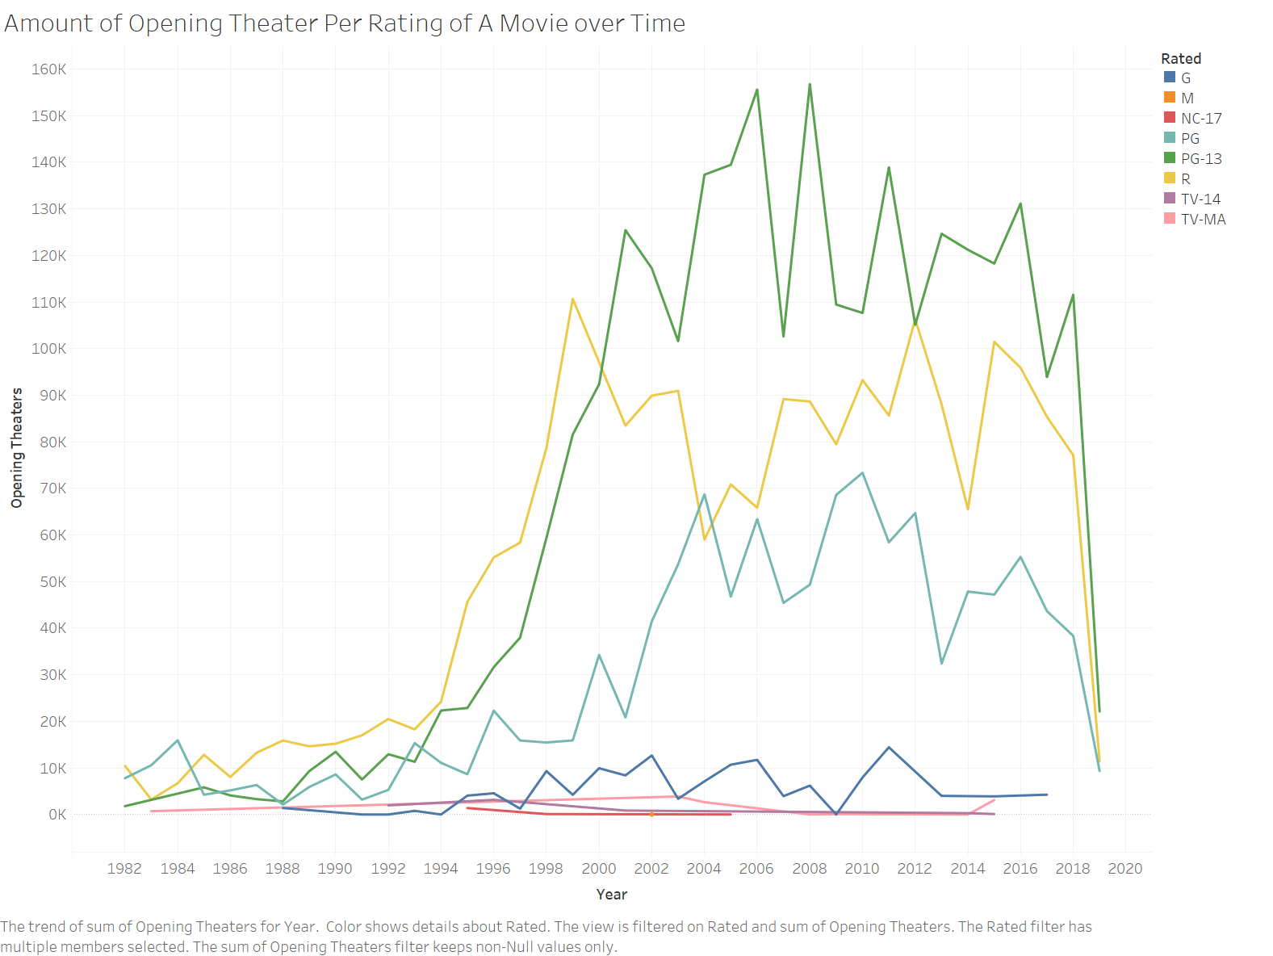
Theater Openings
You notice the change in popularity throughout the years
Notes:
In 2007 PG-13 movies saw its biggest drop in theater openings based on our data. The reason for this was that although they movies were PG-13 they were not appealing to kids, movies like Juno, Beowulf, I am Legend were released this year.
Rated MA movies do not have a lot of openings not because they are not popular but because of the MPAA policies and policies of Movie Theaters. There are movies theaters through the us that refuse to show adult rated movies.

Slide 5
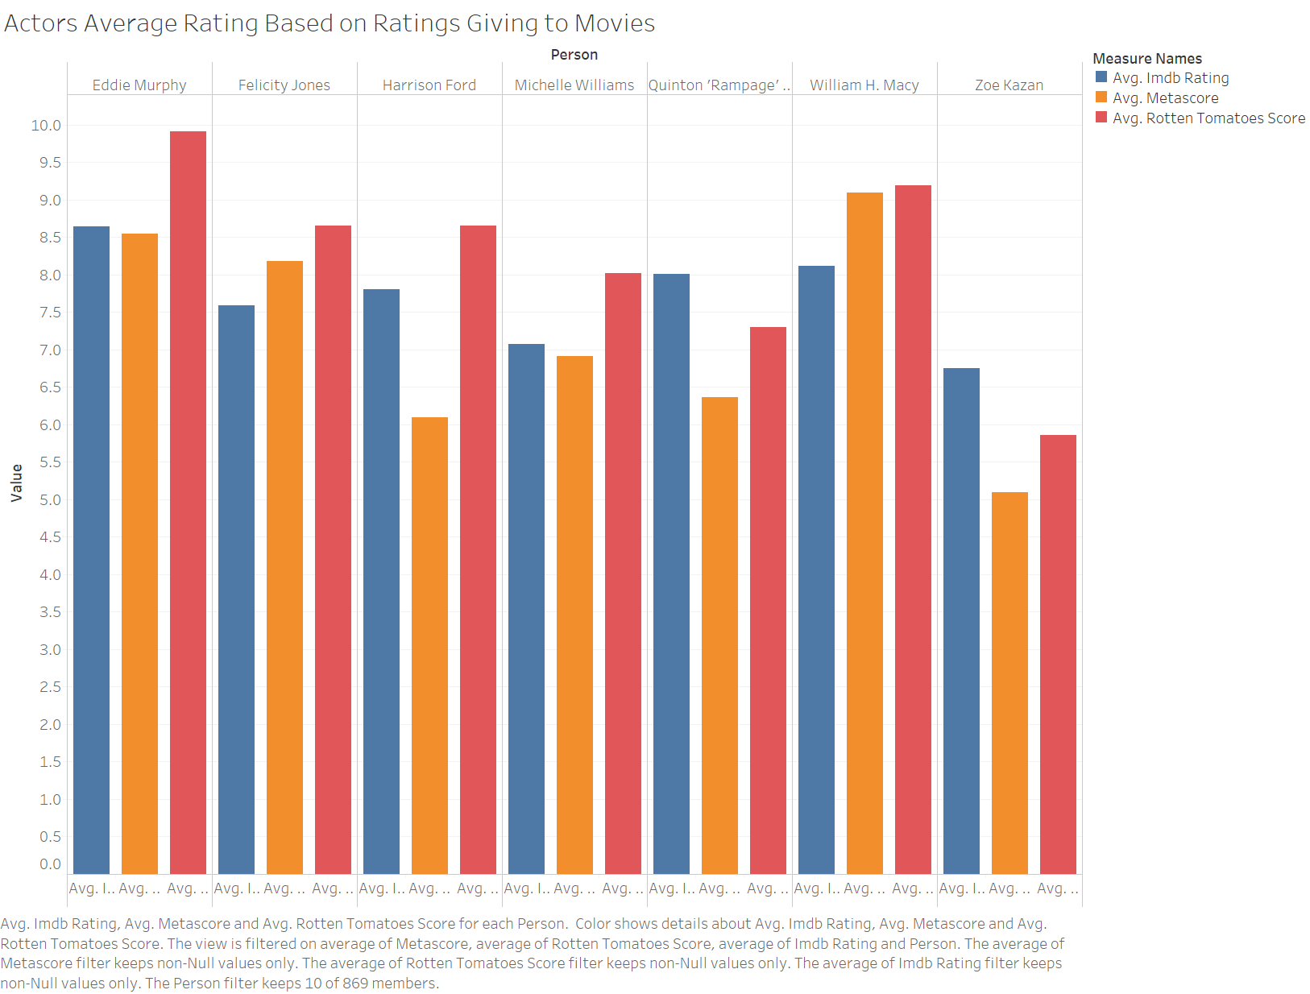
US States Casualty Trend Comparisons
Top 10% of Actors based on their total gross earnings
Note 2018 only includes first quarter
Notes:
To be honest I was a bit surprised when this visualization ended up being created. I was expecting a different set of actors all together. There was a time period in which each actor played a major roles for a specific type of movie, Eddie(Comedy), Felicity(Adventure),Harrison(Adventure),Michelle(tragic/dark) ect.

Slide 6
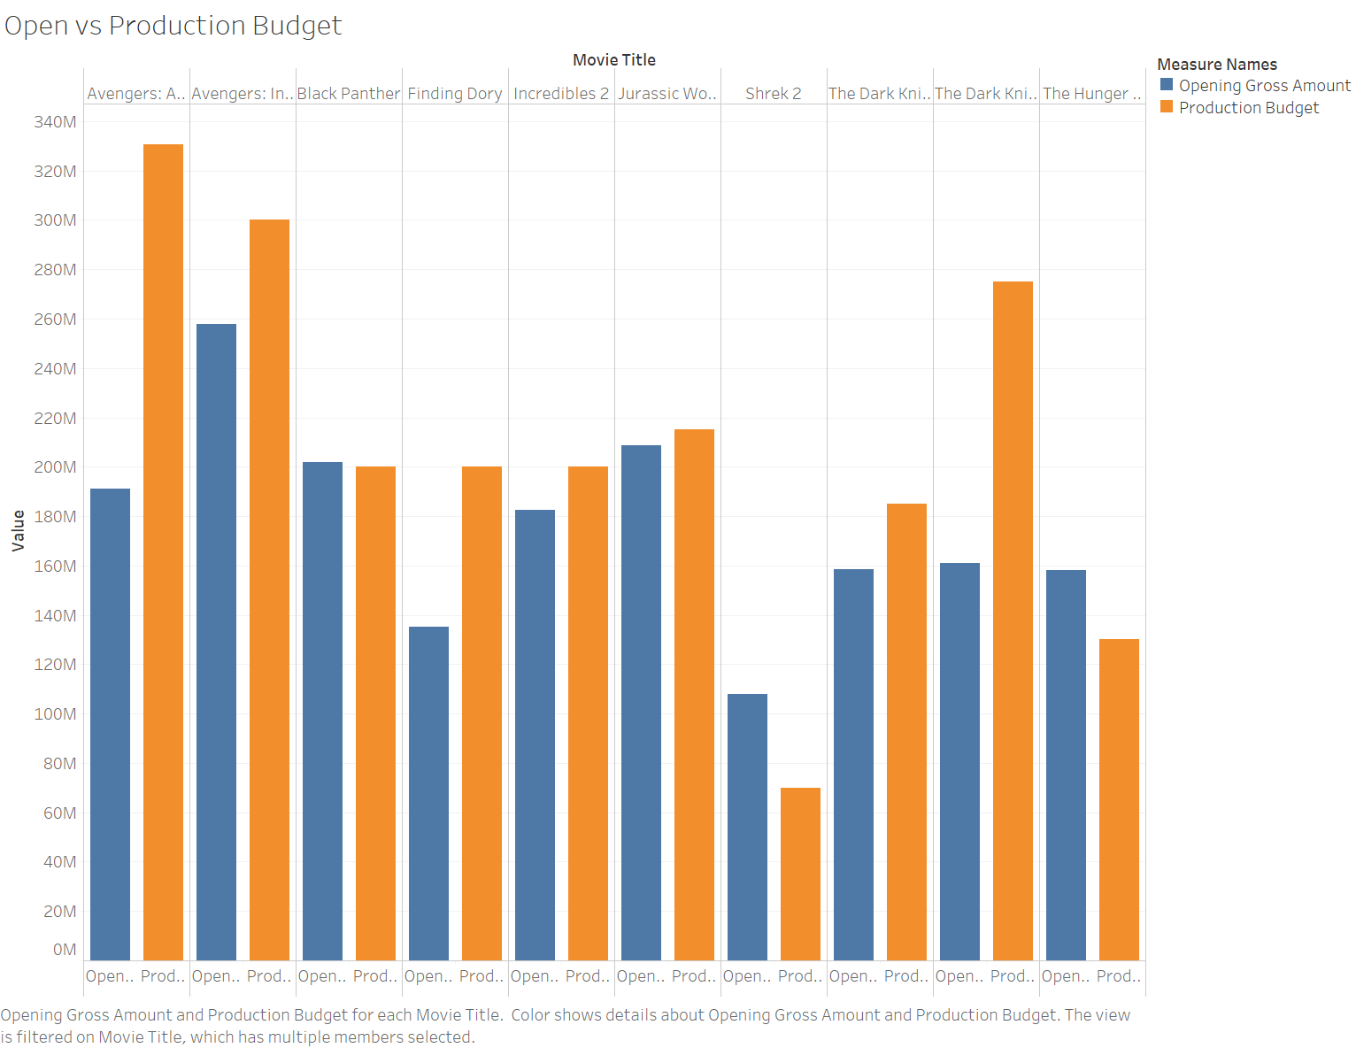
Americans Favorite Type of Rated Movie
Opening vs Production Budget
Notes:
This was not surprising. The past few Marvel movies have broken box offices records one after another. Just on opening days these movies have earned more than half of their initial production budget.

Slide 7
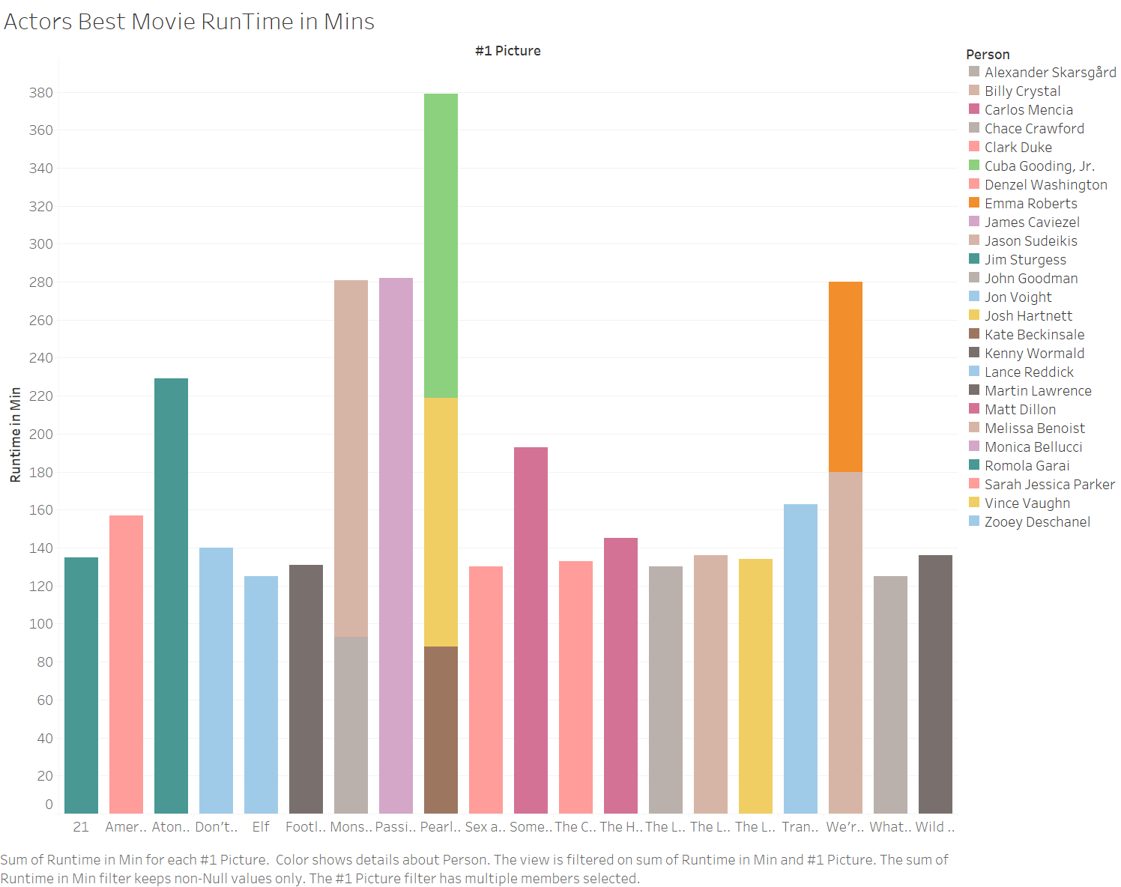
Actors Best Movies
Movies in which resulted in Actors highest rated and grossed movie

Slide 8
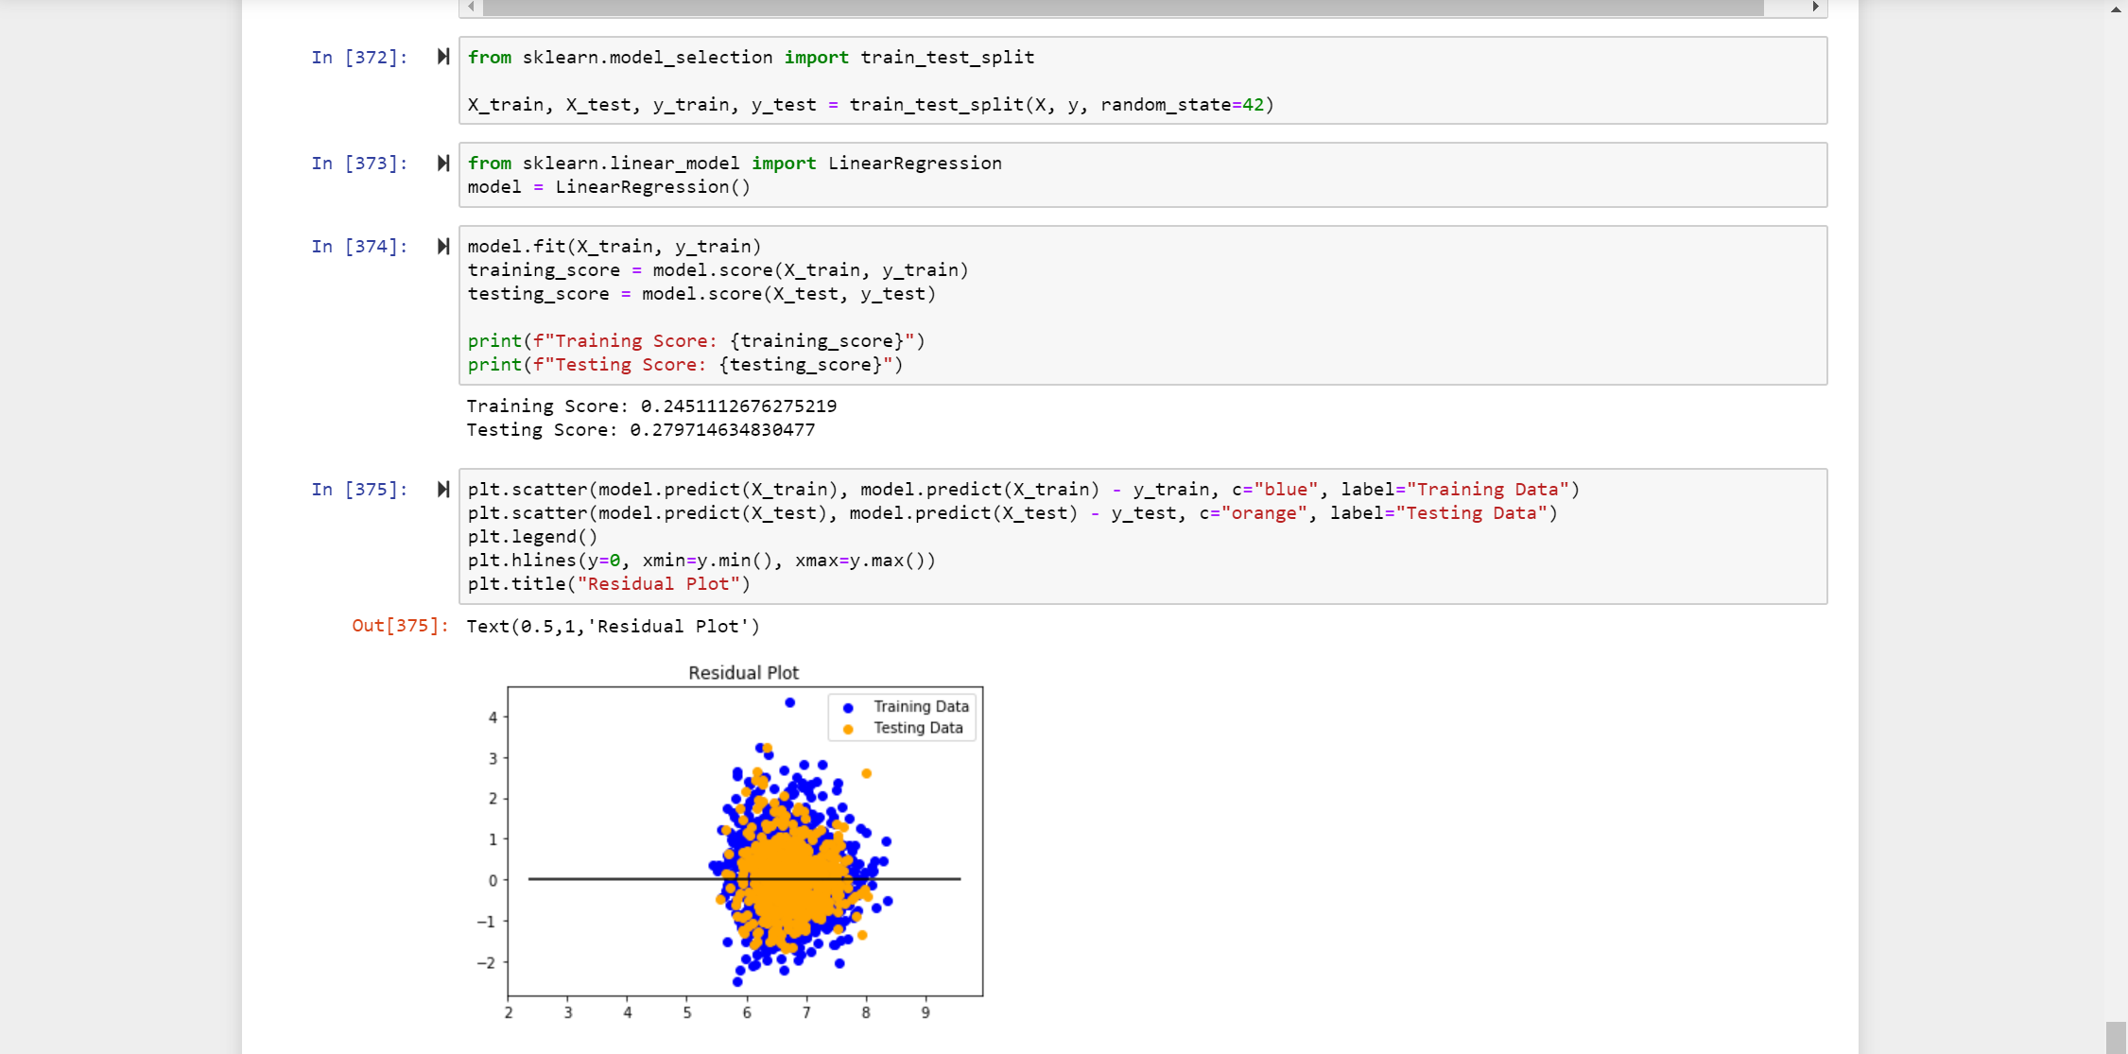
Our attempt to Machine Learning
Features used
Why Linear regression was used
What can this model theoretically predict?
Notes:
Runtime in Min", "Action", "Adventure", "Animation", "Biography", "Comedy", "Crime",
"Documentary", "Drama", "Family", "Fantasy", "Film Noir", "History", "Horror",
"Music", "Musical", "Mystery", "Romance", "Sci-Fi", "Short", "Sport", "Superhero",
"Thriller", "War", "Western", "Actors Avg Total Gross", "Actors Avg Number of Movies",
"Actors Avg Best Picture Gross", "Director Total Gross", "Director Number of Movies", "Director Best Picture Gross",
"Title Compound Sentiment", "Black", "White", "Gray", "Red", "Yellow", "Green",
"Cyan", "Blue", "Magenta", "Red"

